Slide 1

Primer on Project Data
Soccer Analytics Course
Nicola Lo Russo, Oliver Holl, and Hadi Sotudeh
Social Networks Lab
March 1, 2024
Notes:
1

Slide 2


Nicola Lo Russo
Computational Science and Engineering student
Soccer Analytics student in 2022
Soccer Analytics TA since 2023
Notes:
2

Slide 3
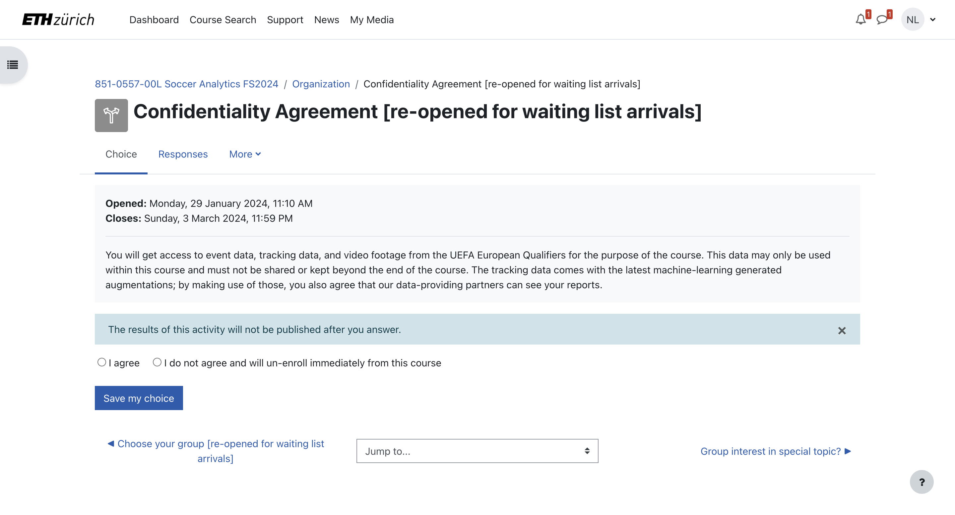
Confidentiality Agreement
Please agree to it on Moodle. Otherwise you and your group won’t have access to the data.
Notes:
3

Slide 4
Confidentiality Agreement
You are allowed to have data only within ETH environment!
Notes:
4

Slide 5
Learning Objectives
Describe the project datasets and how they are collected
Find the definition of each data attribute from the documentation
Use the prepared starting scripts
Make use of shared codes in “snippets”
Notes:
5

Slide 6
Plan
GitLab tour & Video API by Nicola
Event data by Oliver
Break!
Tracking data by Hadi
Event, Tracking, and Video all together by Nicola
Extra Resources and Q&A
Notes:
6

Slide 7
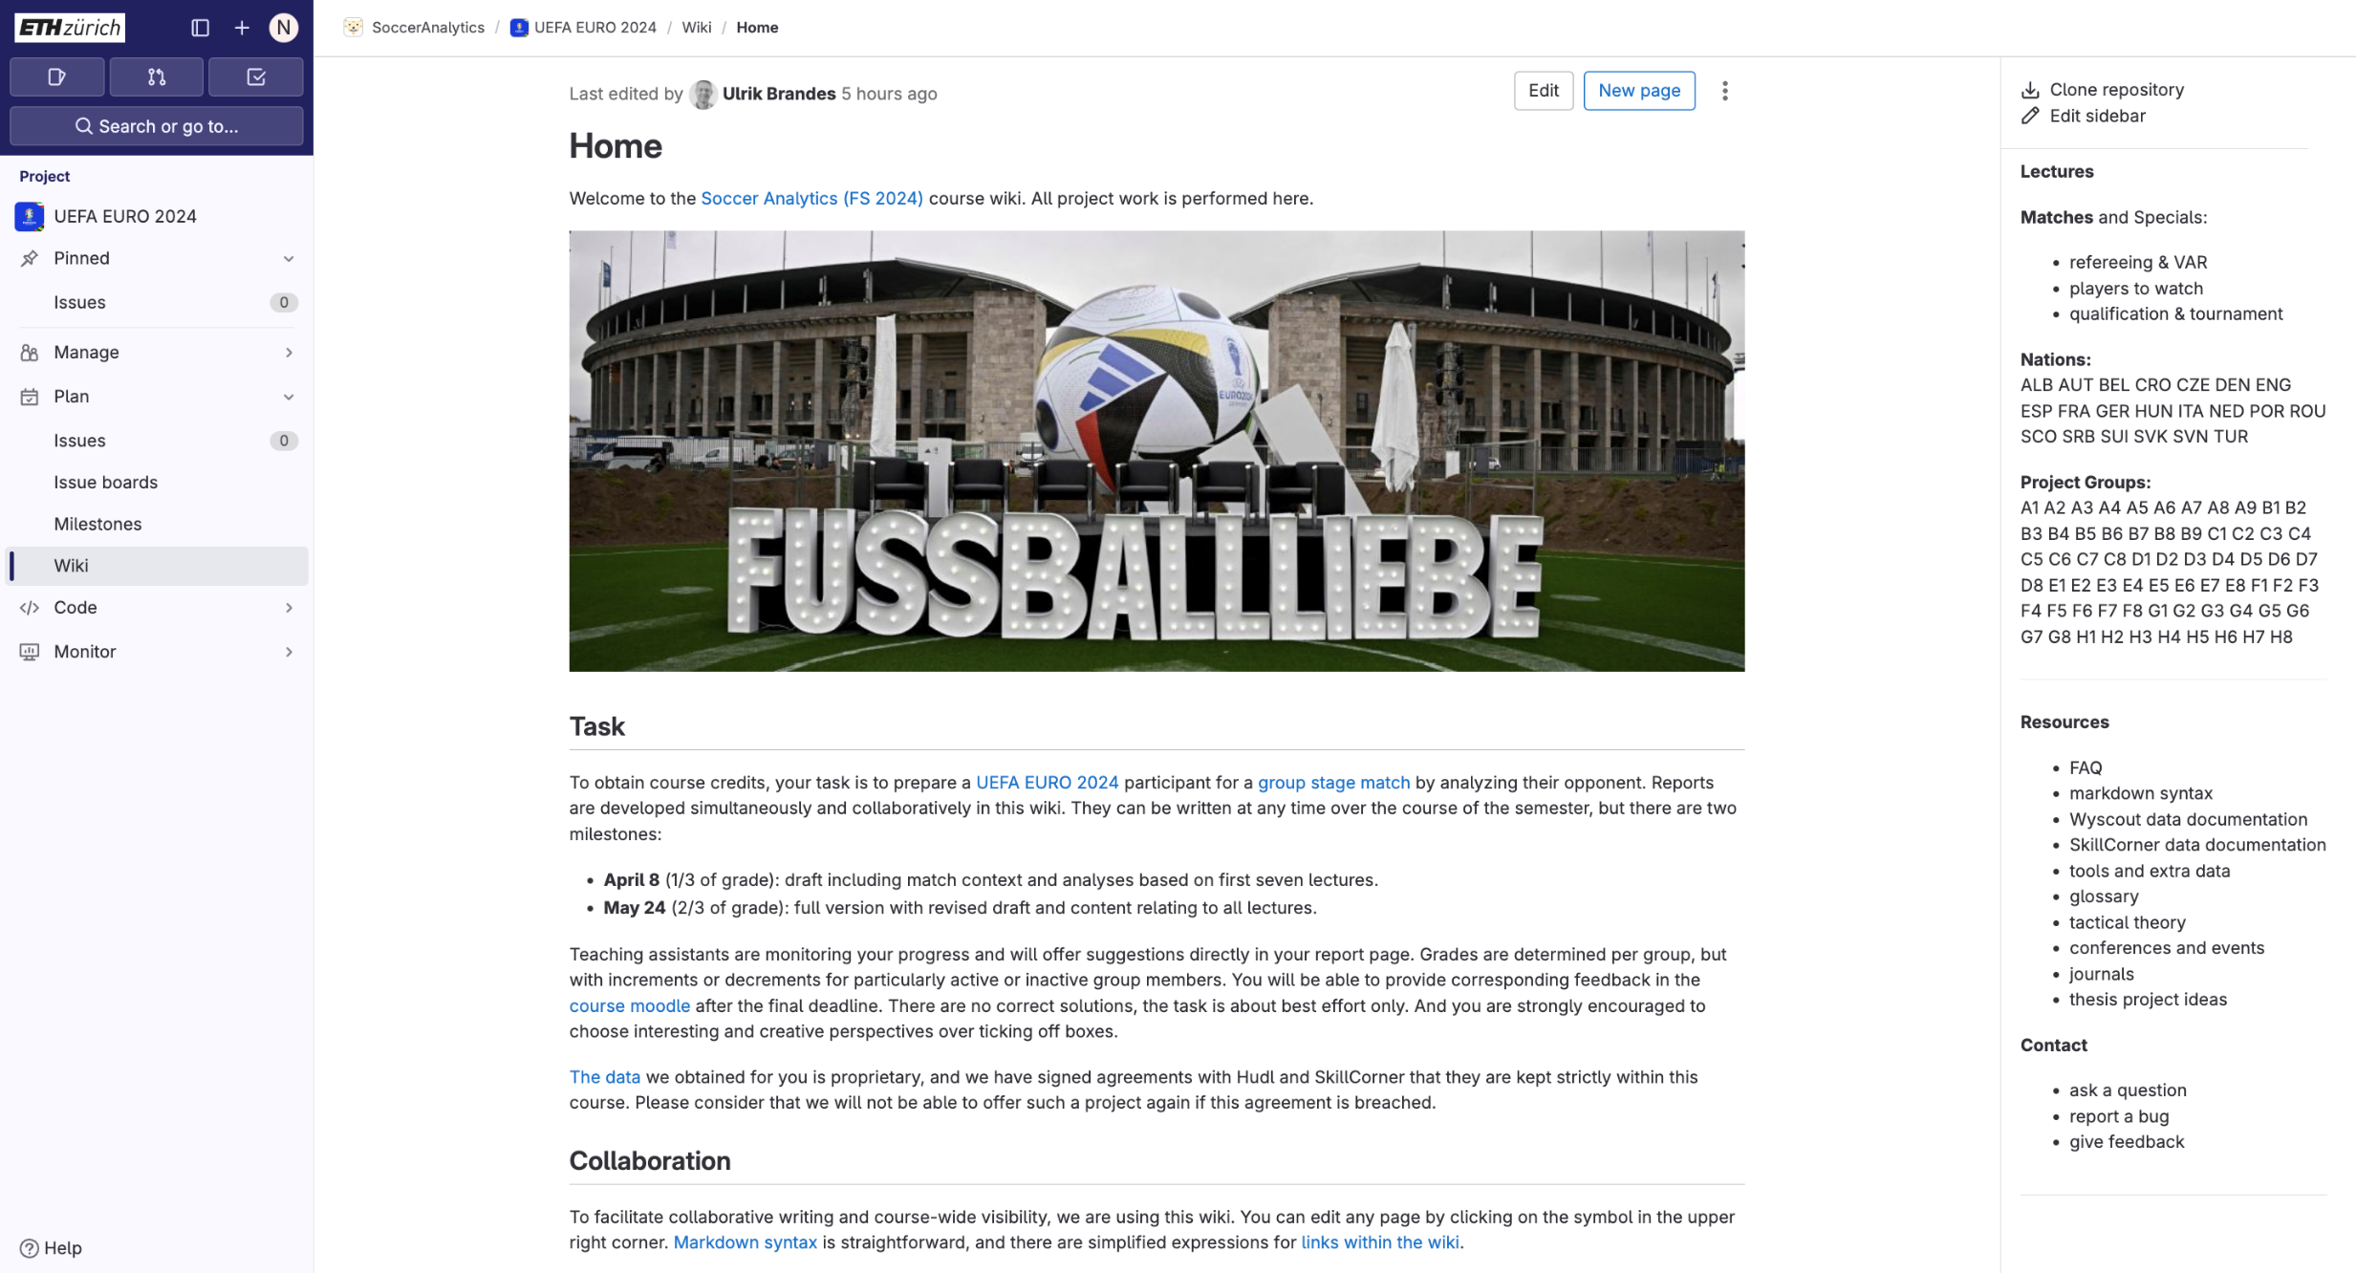
How to GitLab
ALL WORK IS DONE HERE!
Notes:
Tell them why it matters (real project) in football, you will use the same type of datasets
7

Slide 8
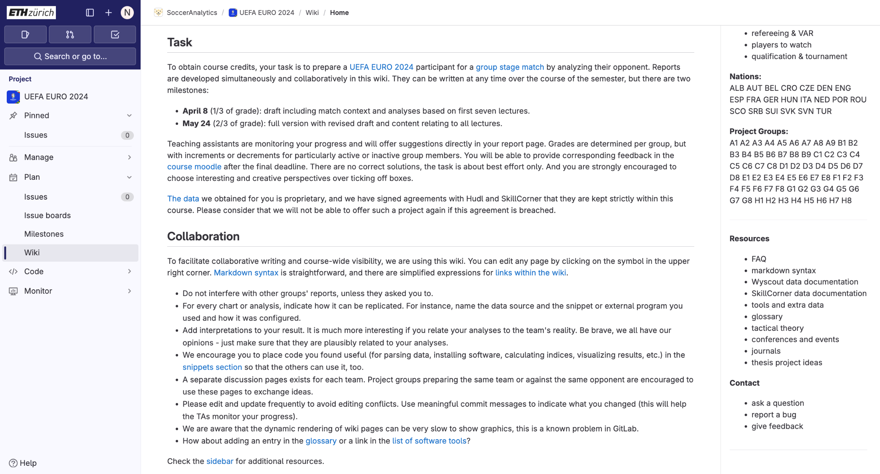
How to GitLab
First draft: April 8 (after spring break)
Worth: 1/3 of final grade
COLLABORATION IS STRONGLY ENCOURAGED
Notes:
Tell them why it matters (real project) in football, you will use the same type of datasets
8

Slide 9
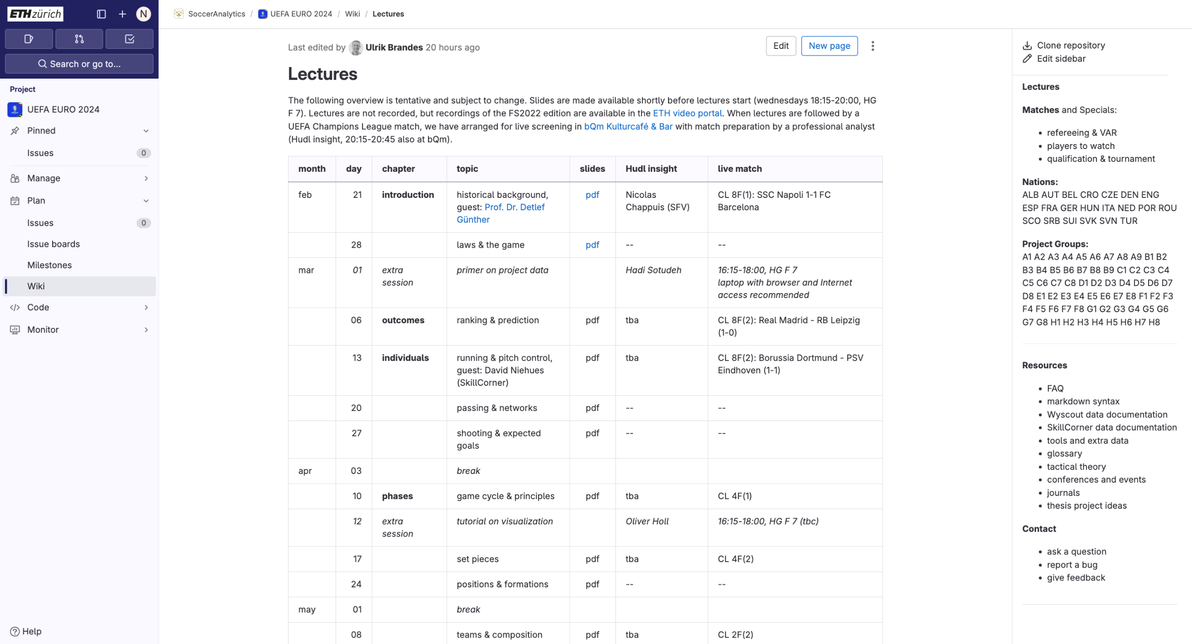
Course overview
YOU ARE HERE!

Slide 10
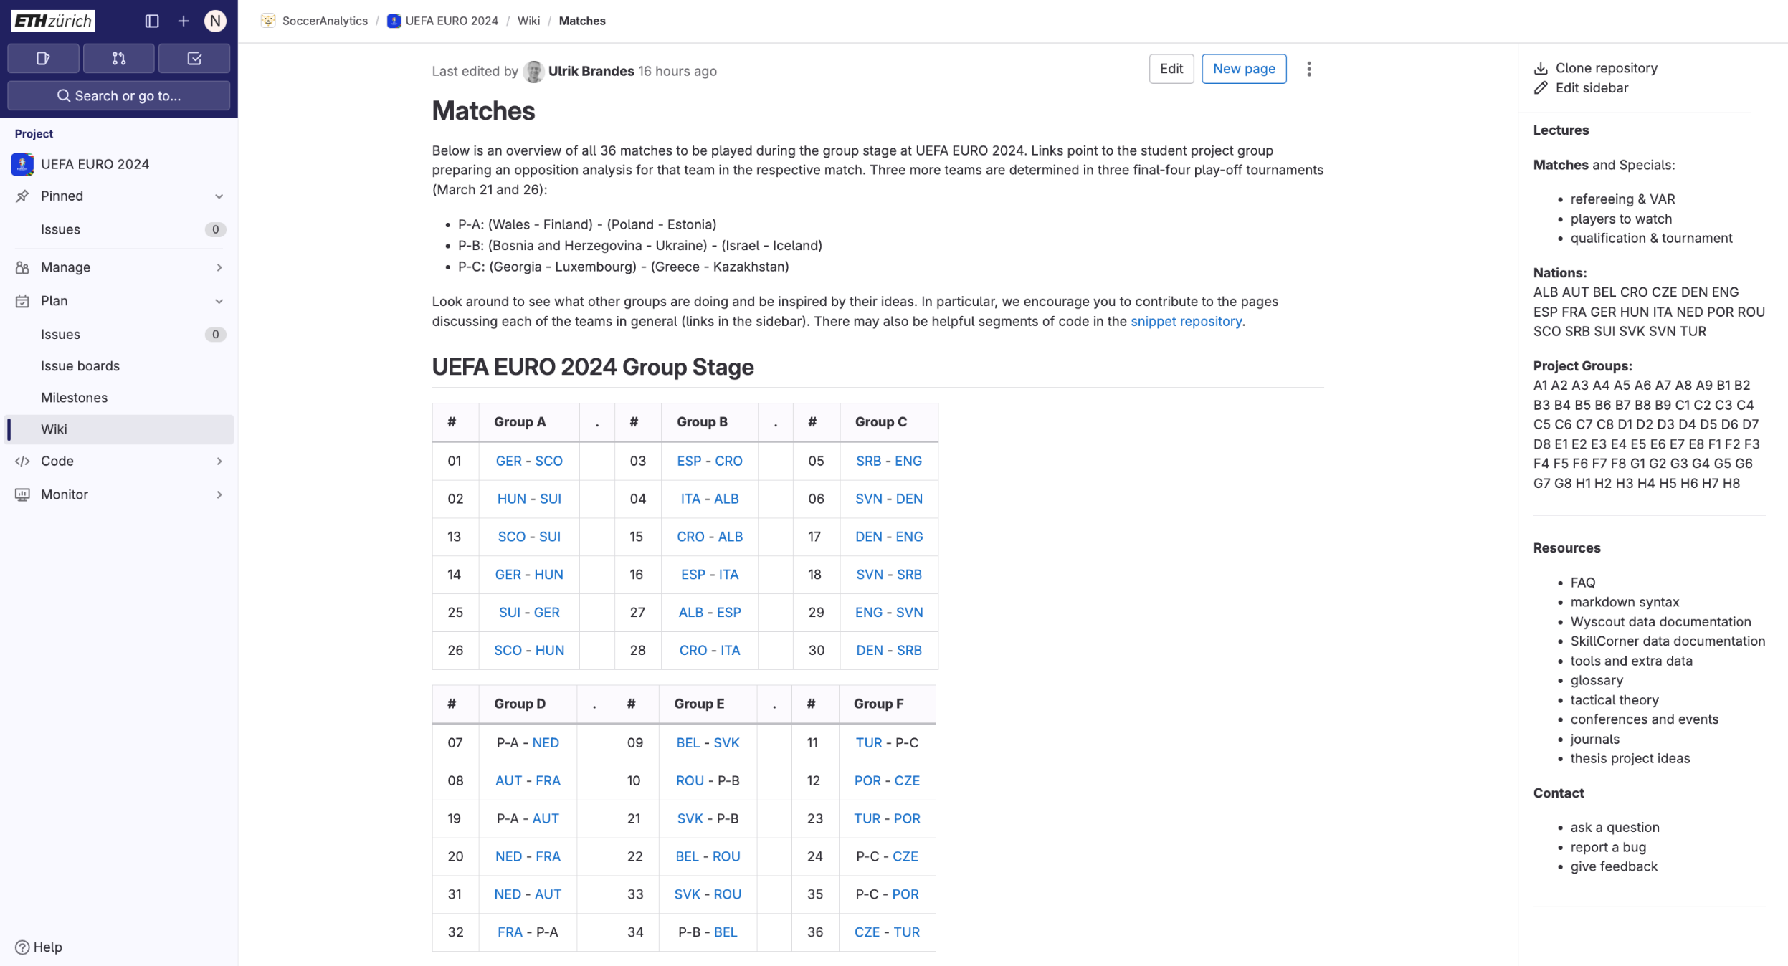
Matches overview

Slide 11
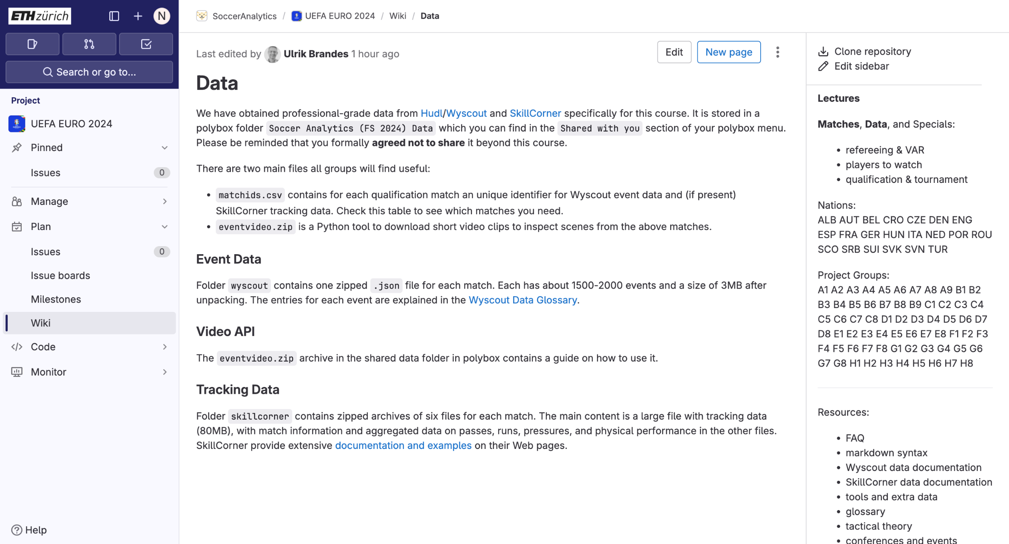
Data
You should find all data in your Polybox.

Slide 12
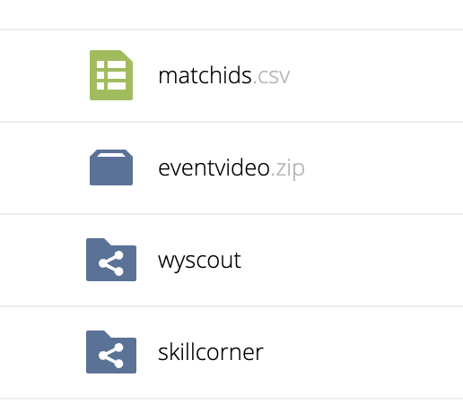
Data
Polybox
We will go over all data in the next slides.

Slide 13
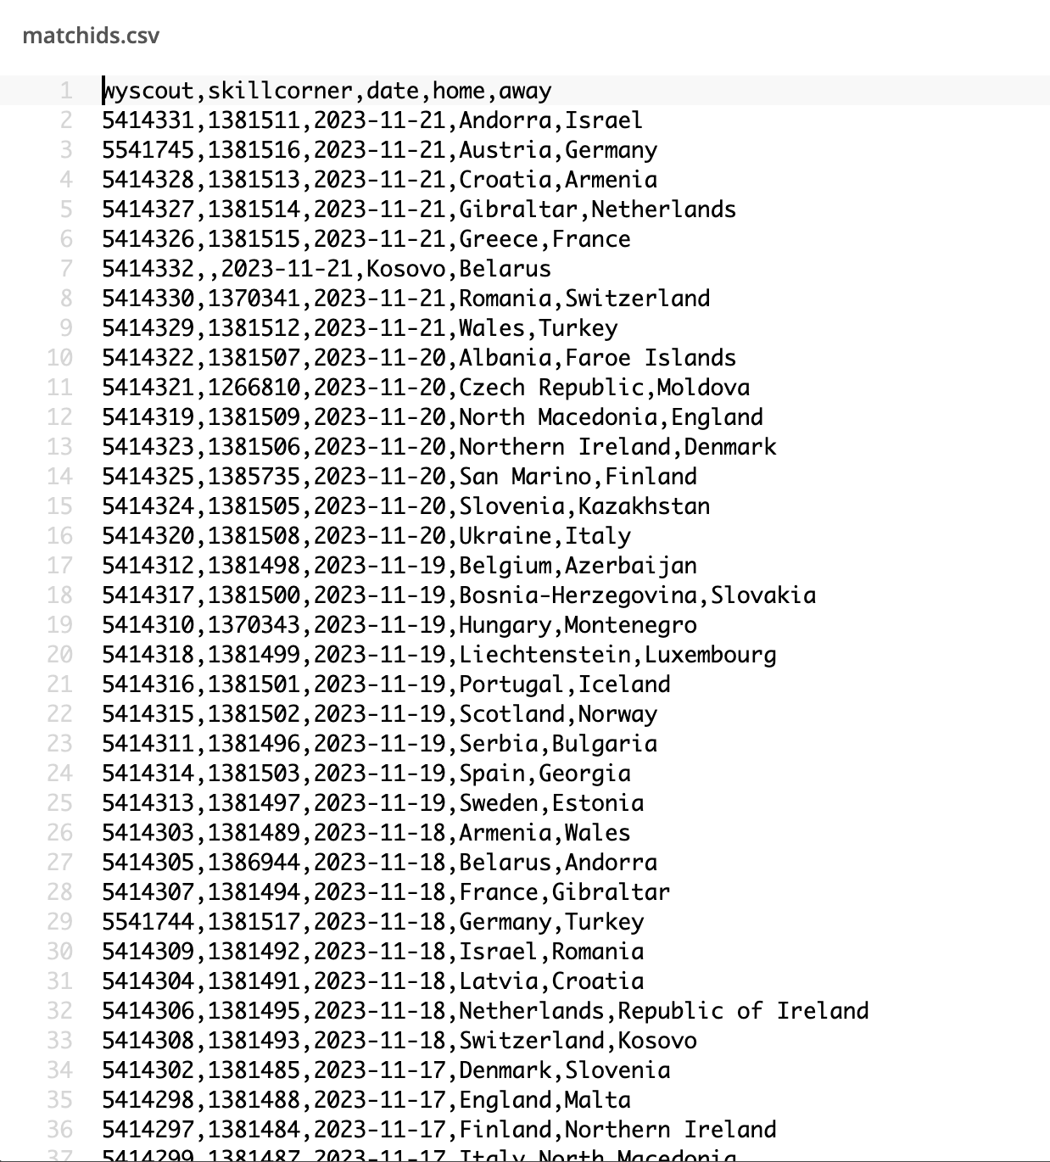
Data
Matches have up to two IDs: one for event data and one for tracking data.
Some matches only have event data.

Slide 14
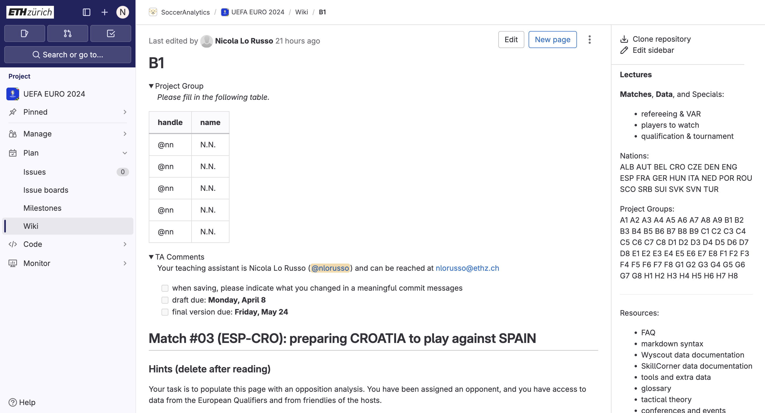
Project wikis
ADD YOUR NAMES HERE

Slide 15

Project wikis
TA COMMENTS WILL APPEAR HERE

Slide 16
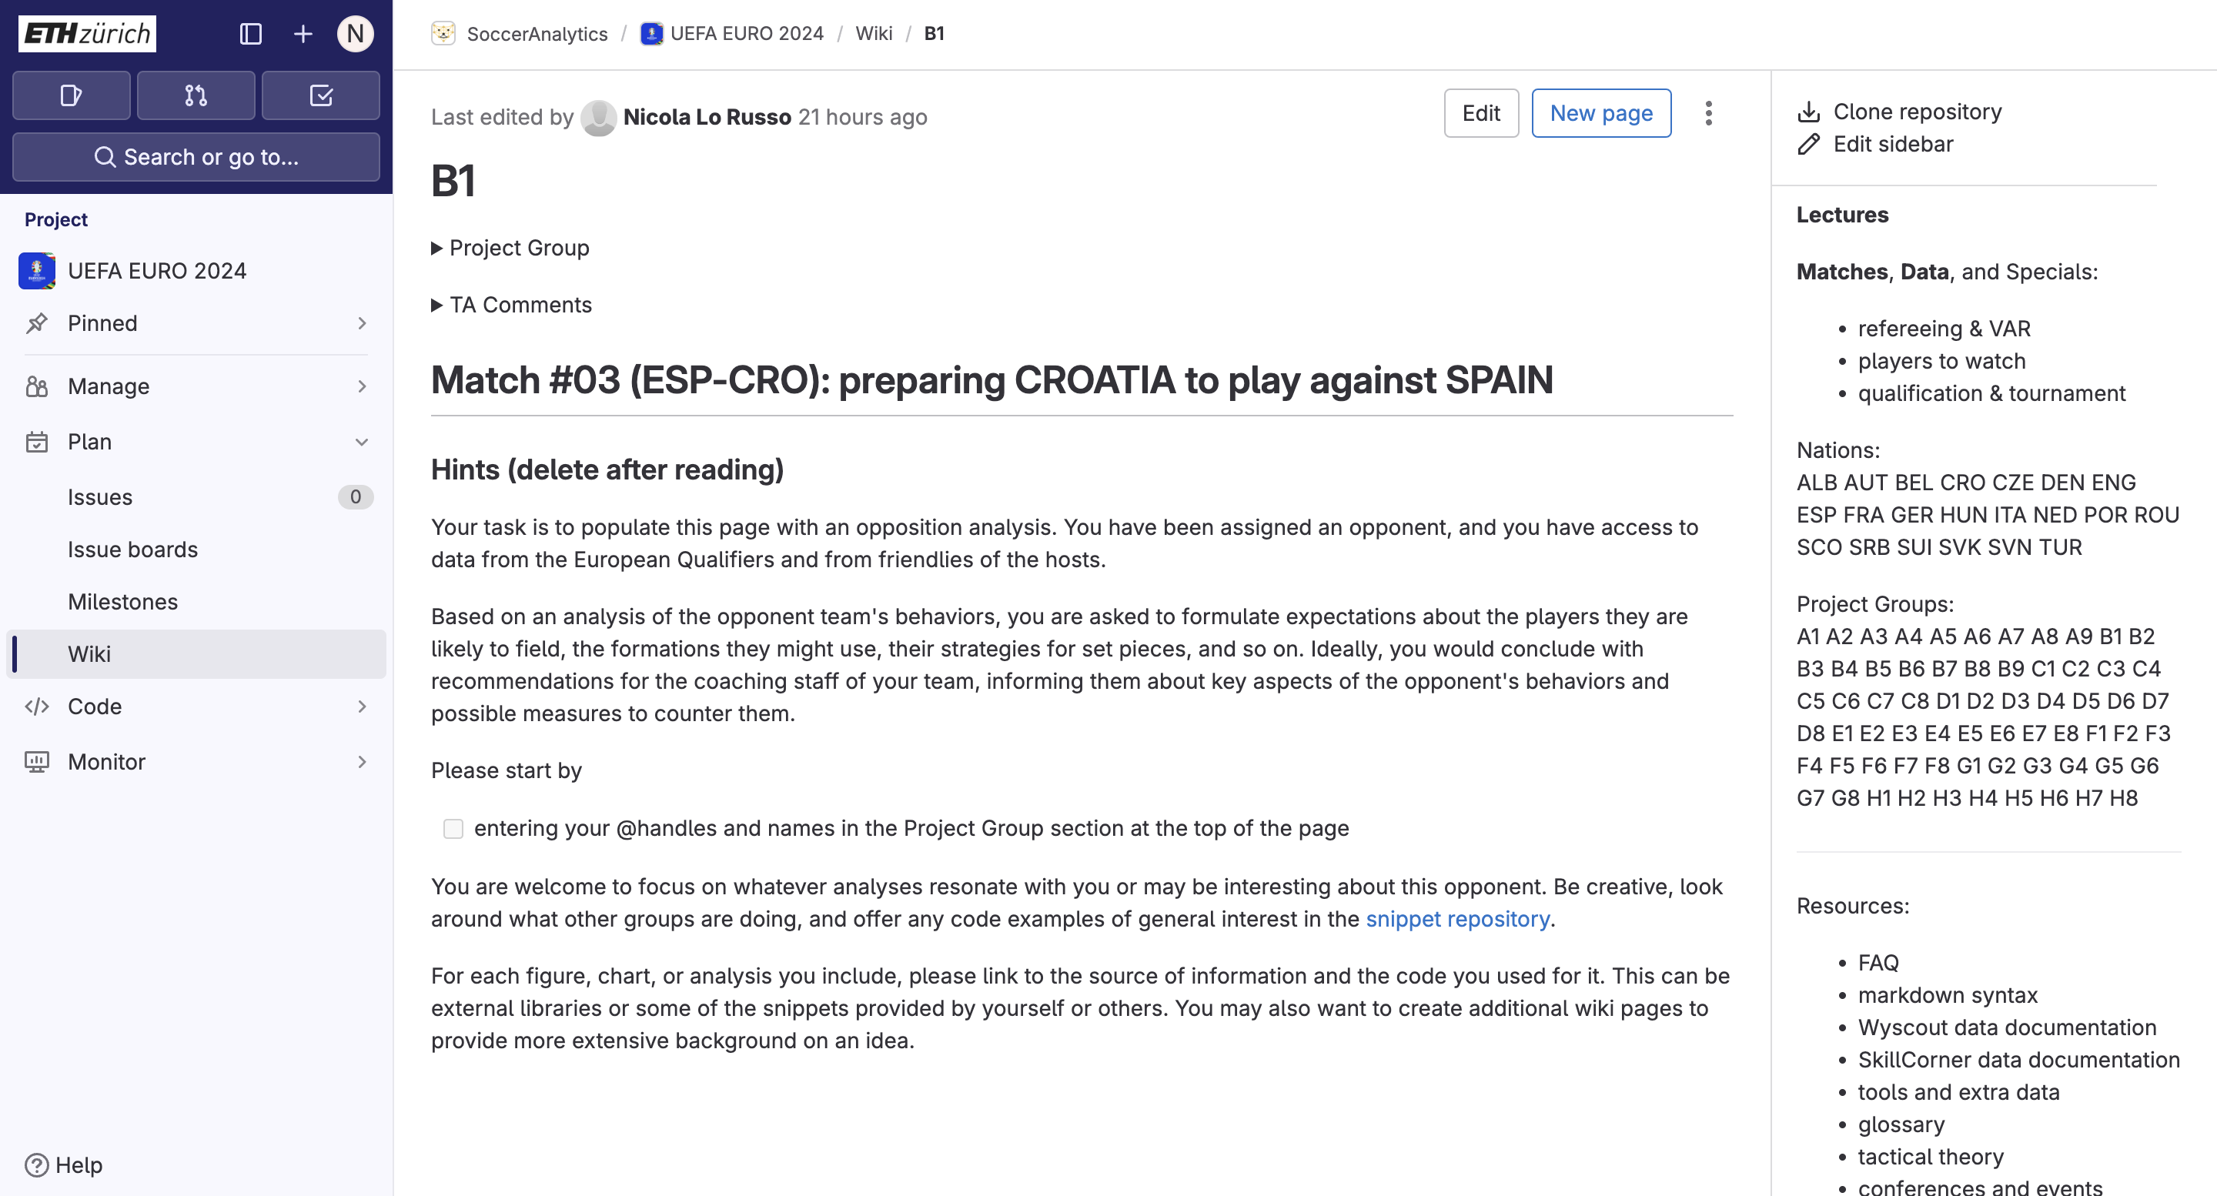
Project wikis
We encourage creativity.
There is not a fixed scheme for the reports.

Slide 17
Project wikis
When you edit the page always make sure to add an informative update message.

Slide 18
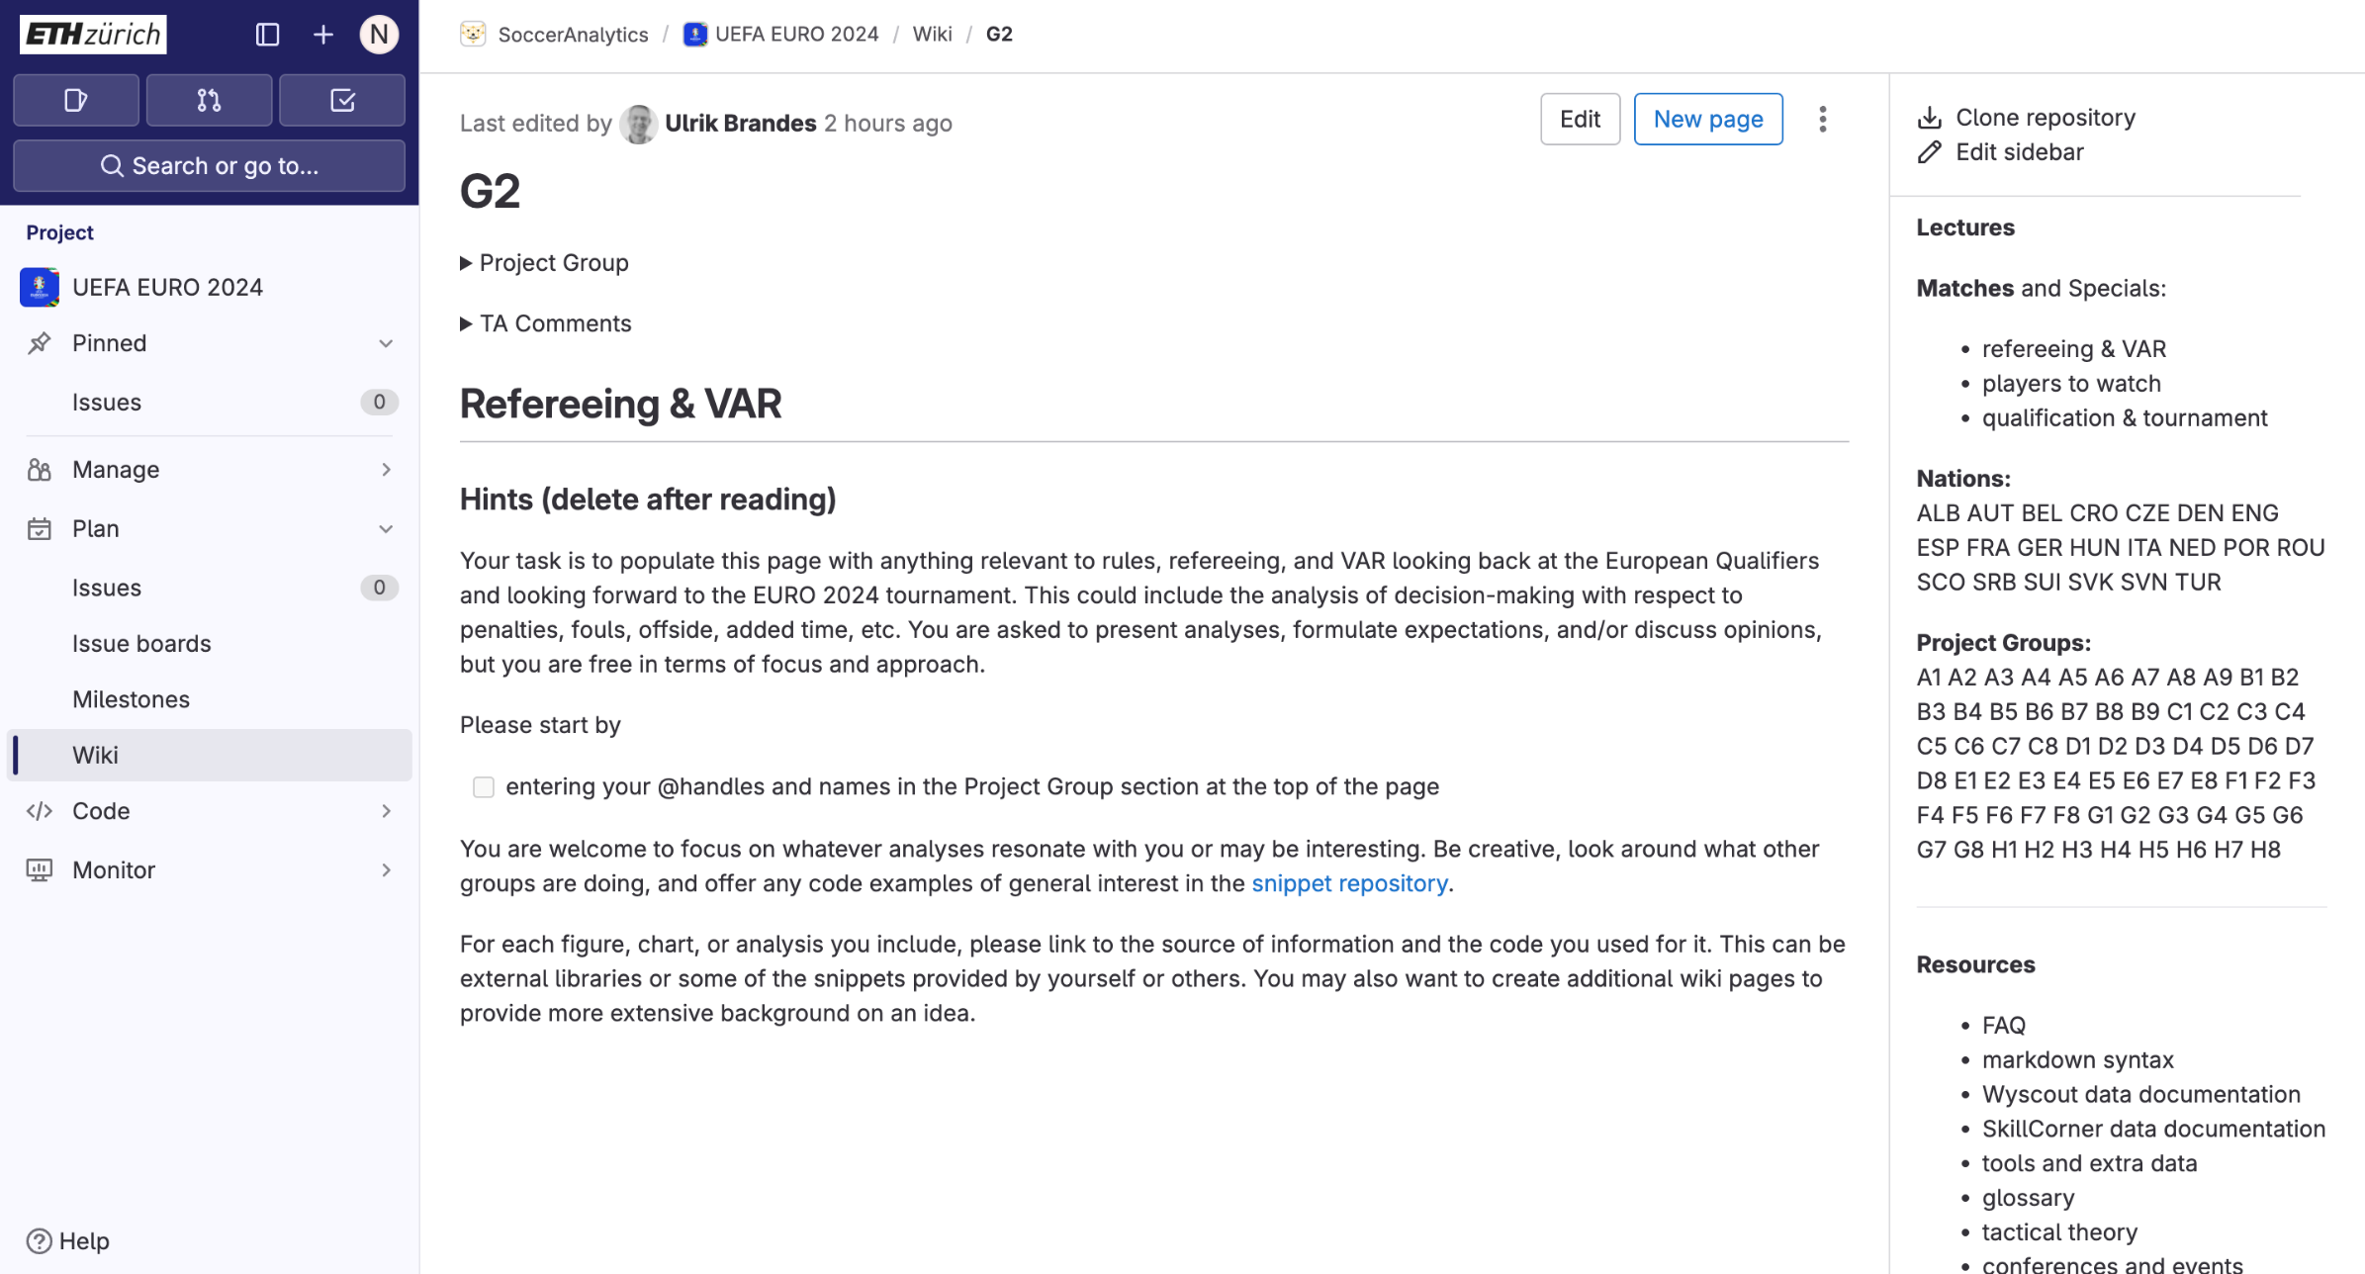
Special assignments
There are 3 groups focusing on special assignments.

Slide 19
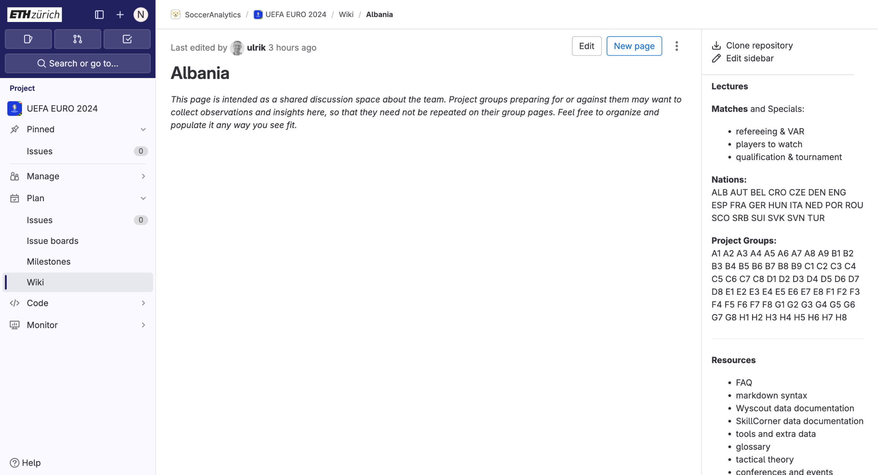
Nation discussions
One page per nation, intended for groups to collaborate and discuss about the nation they are all analyzing.

Slide 20
Nation discussions
Groups related to Albania can all participate to the discussion in this page.

Slide 21
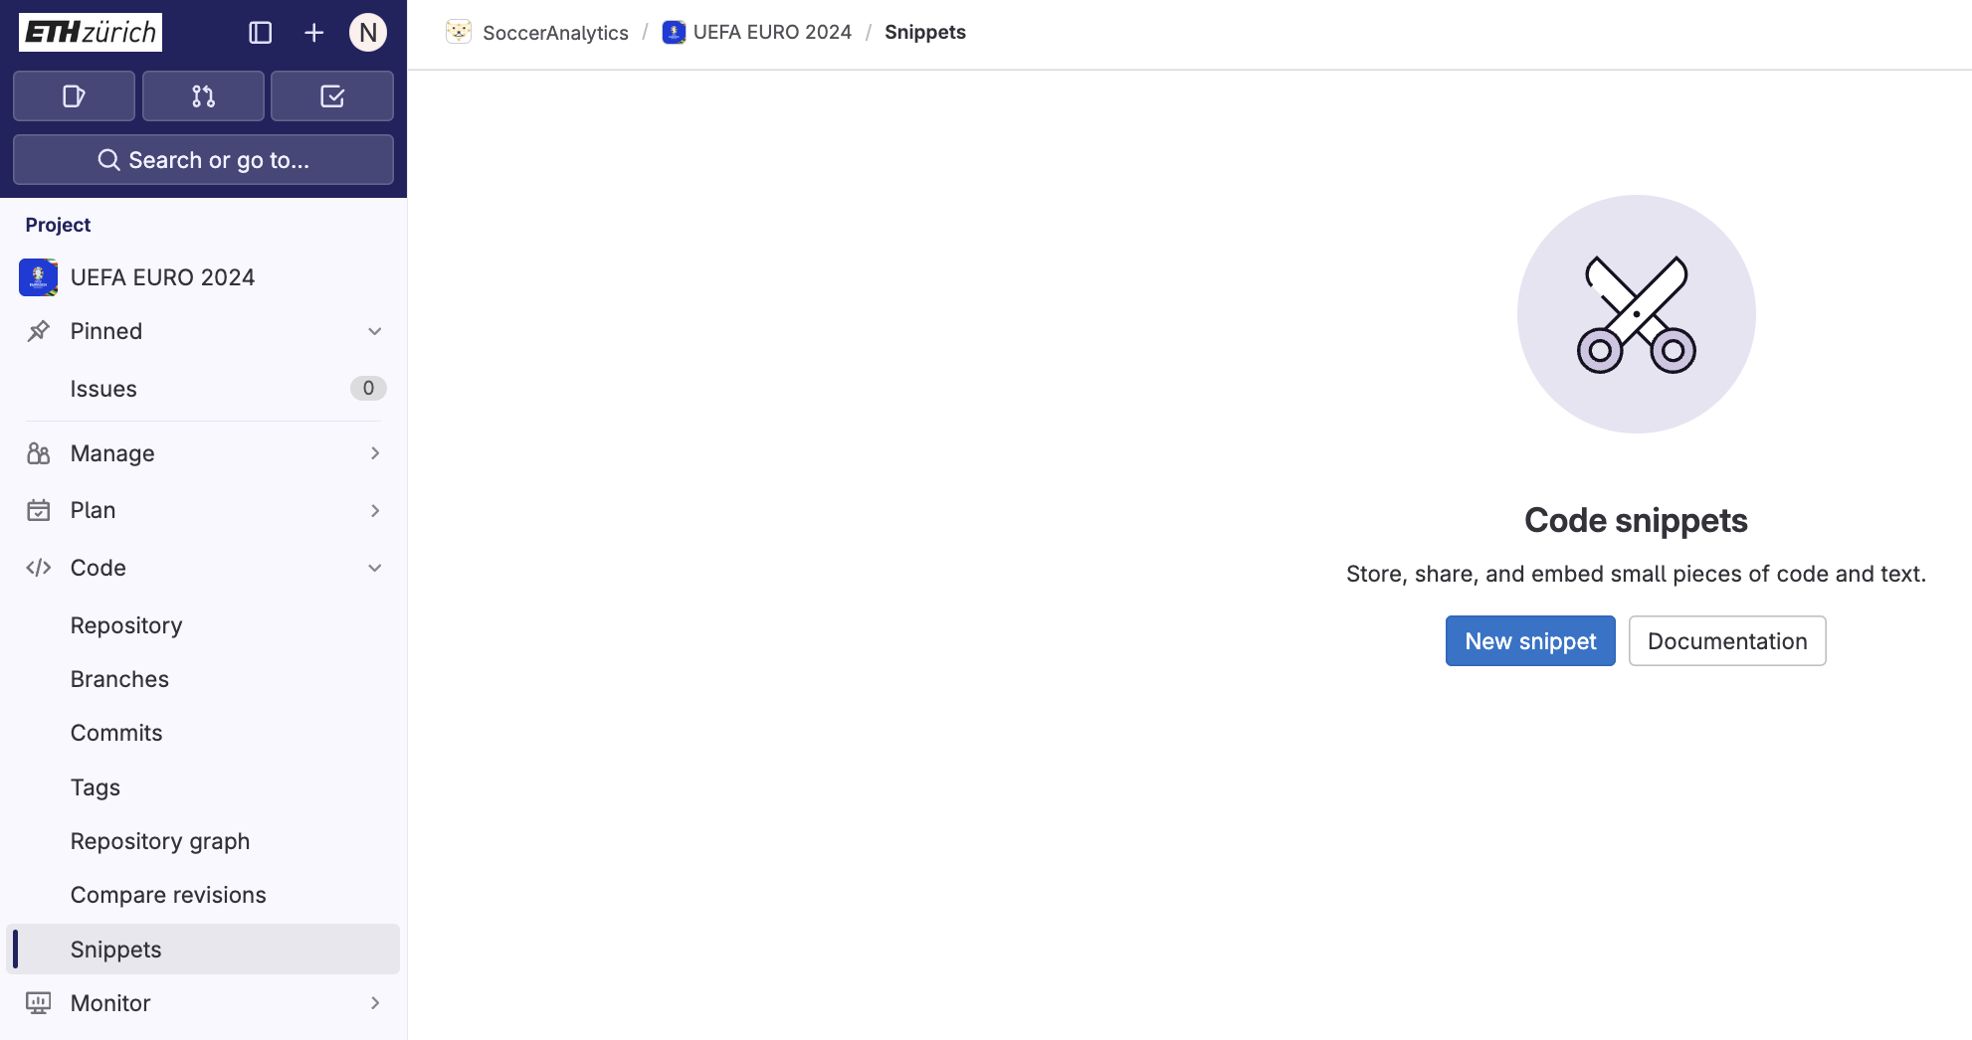
Snippets
You are strongly encouraged to share code snippets with your colleagues.
Everyone can use every snippet.
In your reports, add source to every snippet you use.

Slide 22
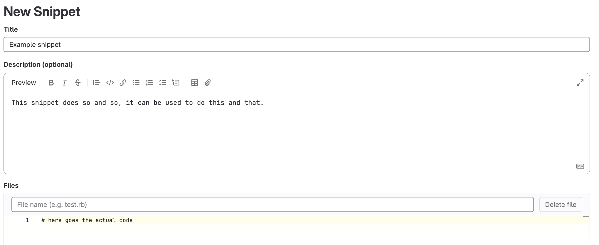
Snippets
Please give a description of the snippet when you add one!

Slide 23
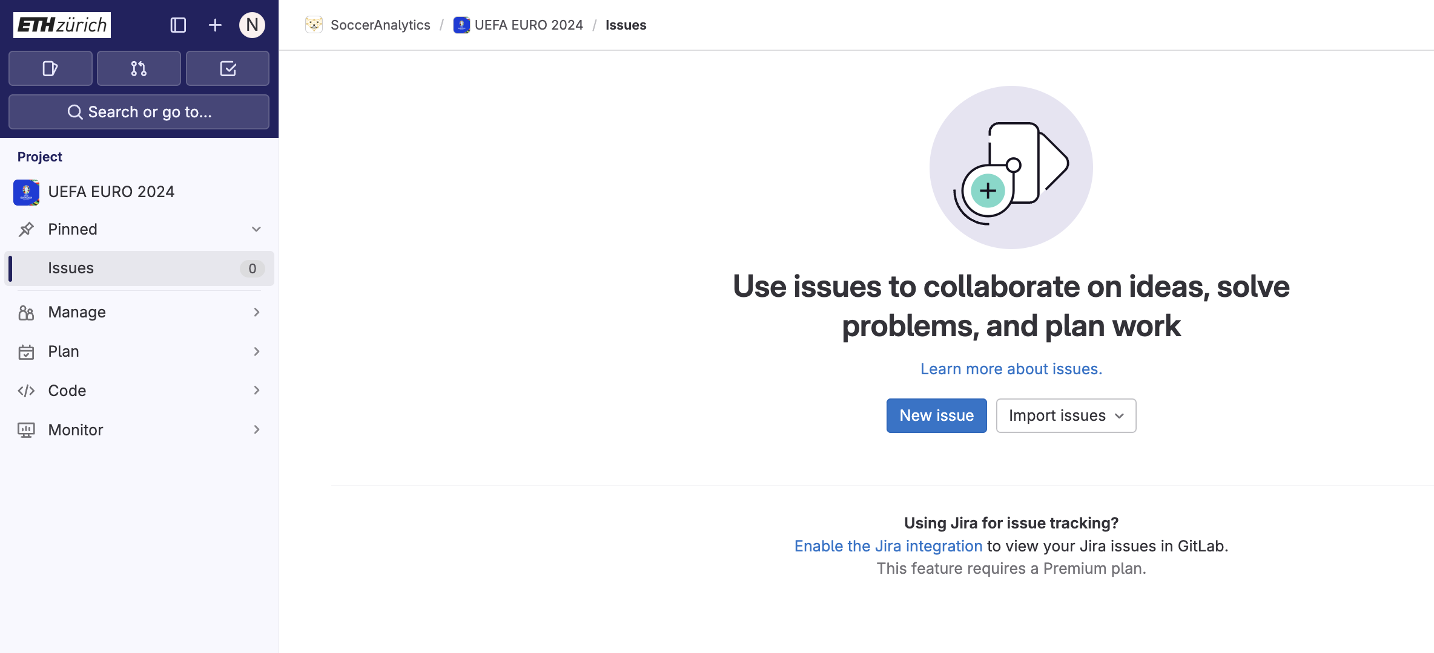
Issues
Ask questions, report bugs, give feedbacks, … Better and more straightforward than emails
Notes:
Tell them why it matters (real project) in football, you will use the same type of datasets
23

Slide 24
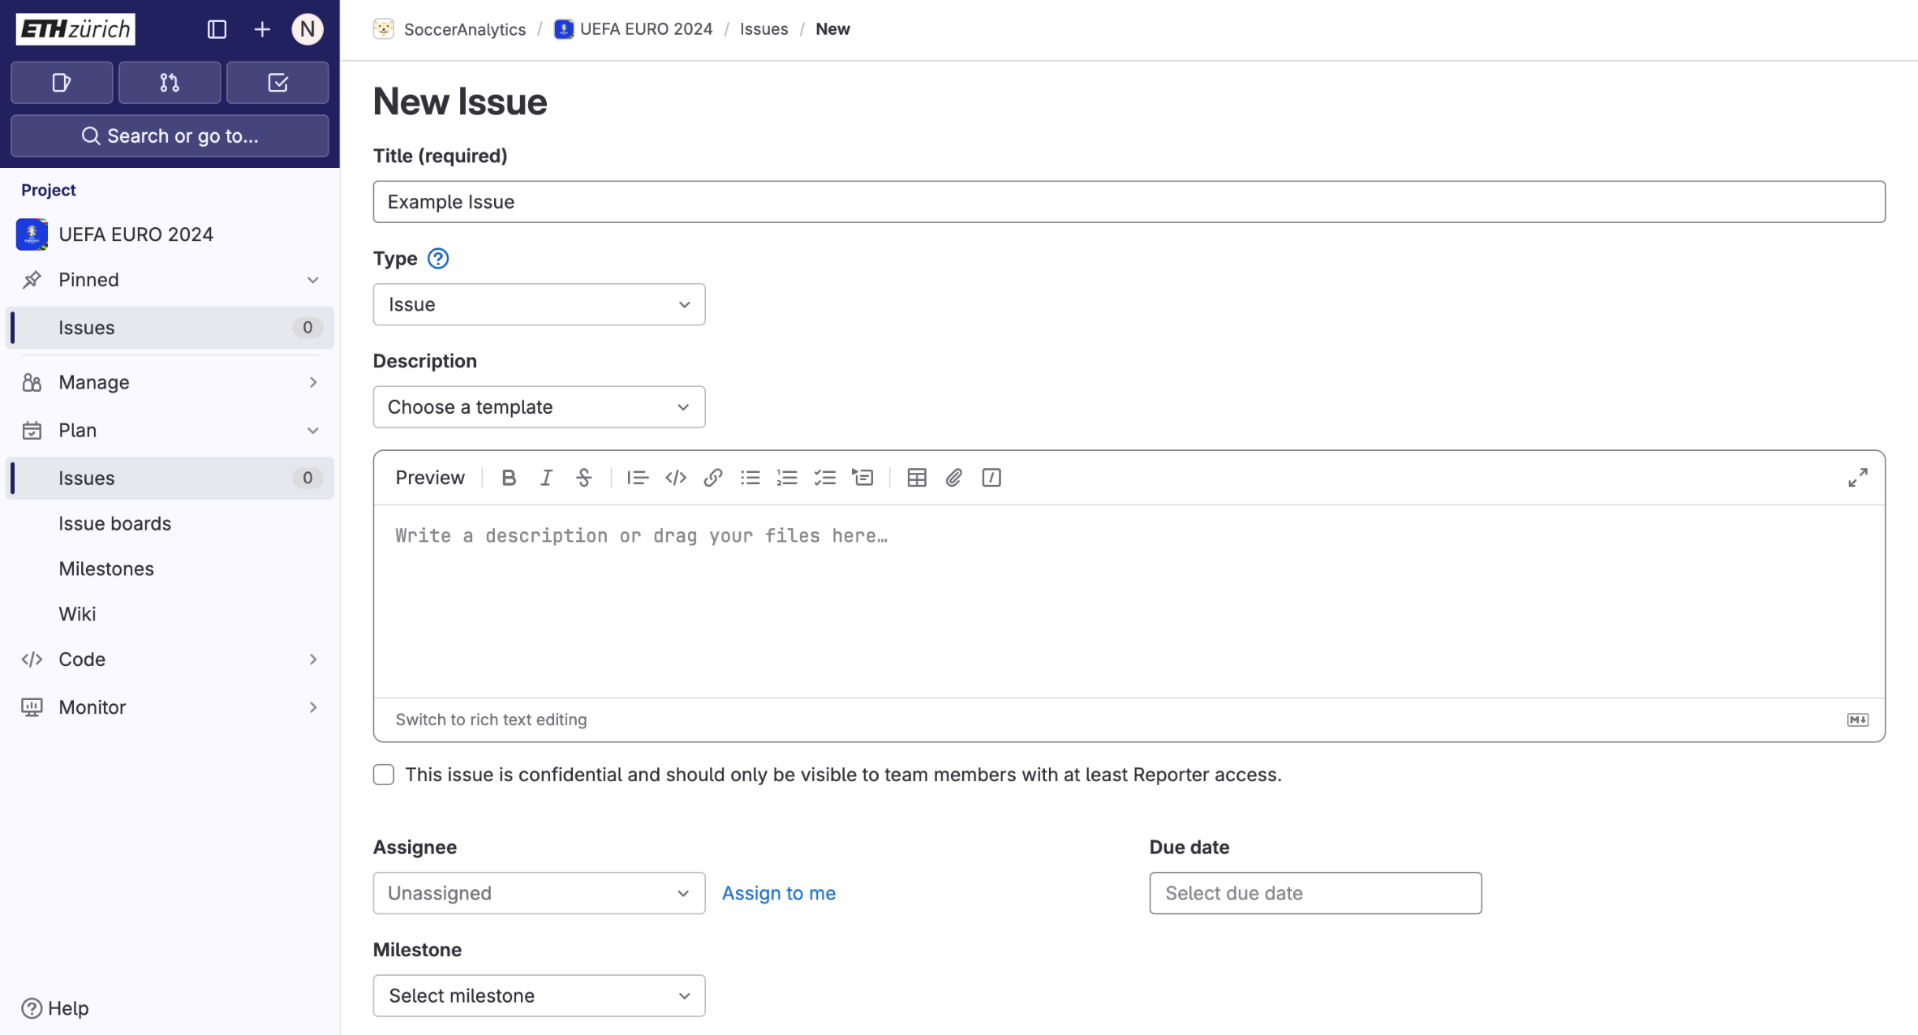
Issues
Add informative title and description.
Notes:
Tell them why it matters (real project) in football, you will use the same type of datasets
24

Slide 25
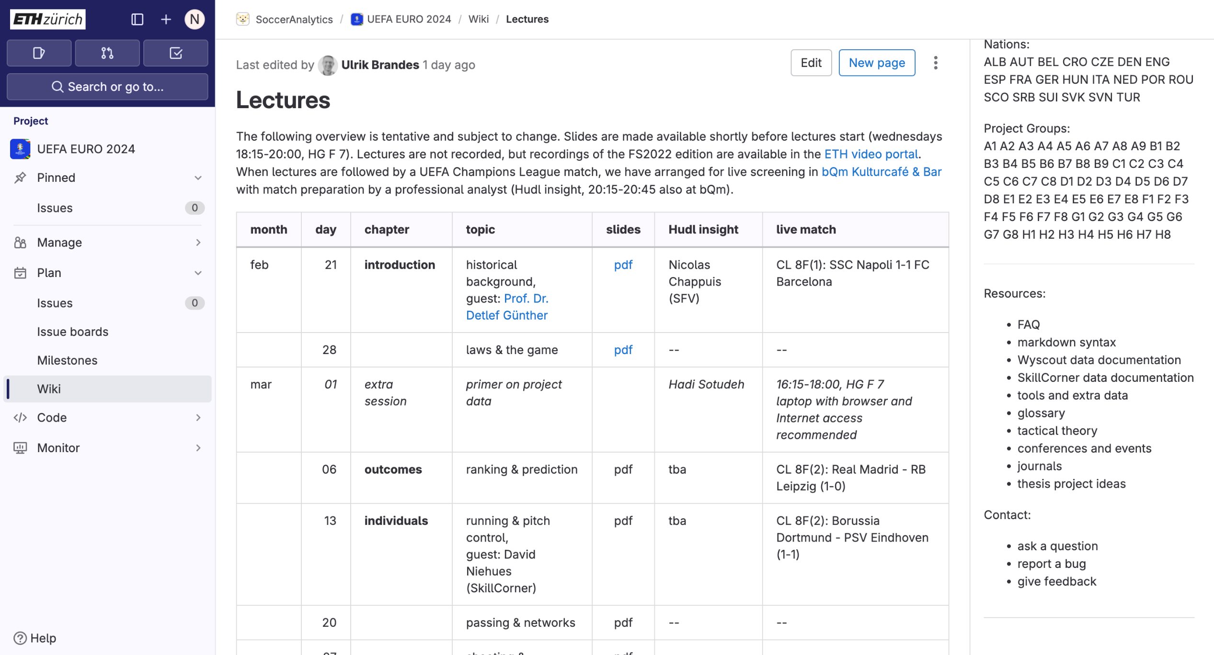
Issues: shortcut
Clicking here takes you directly to Issues. Use this shortcut!
Notes:
Tell them why it matters (real project) in football, you will use the same type of datasets
25

Slide 26
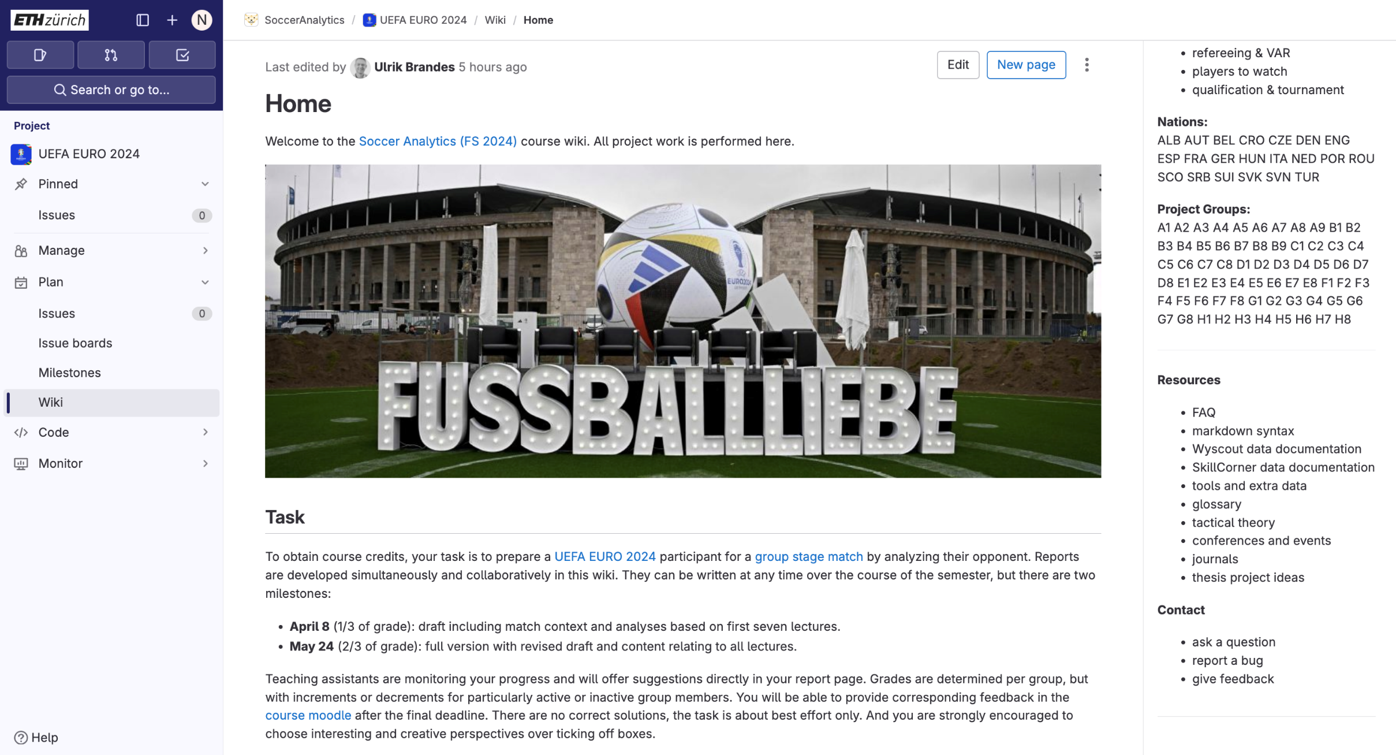
Material
Resources and materials are listed here
Notes:
Tell them why it matters (real project) in football, you will use the same type of datasets
26

Slide 27
Start
Python installation: https://www.python.org/downloads
In the “First Practical Session” folder, open Terminal/PowerShell:
Install pipenv (virtual environment):
pip install pipenv
Install the required Python Packages:
pipenv install
Open Jupyter Notebook:
pipenv run jupyter notebook
Notes:
27

Slide 28
Video extraction

Slide 29
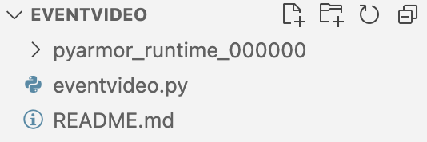
Video extraction
You can make use of the folder “eventvideo” to extract short videos for your analyses.
Follow the instructions in the README file.
Tested in Linux/Windows and some Mac.
29
Notes:
29

Slide 30
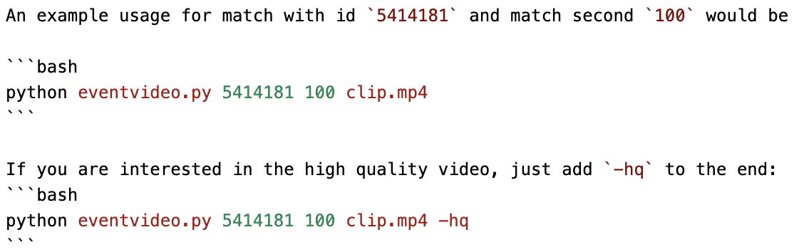
Video extraction
You will get a 10 seconds video of the event (from 4 seconds before to 6 seconds after)
30
Notes:
30

Slide 31
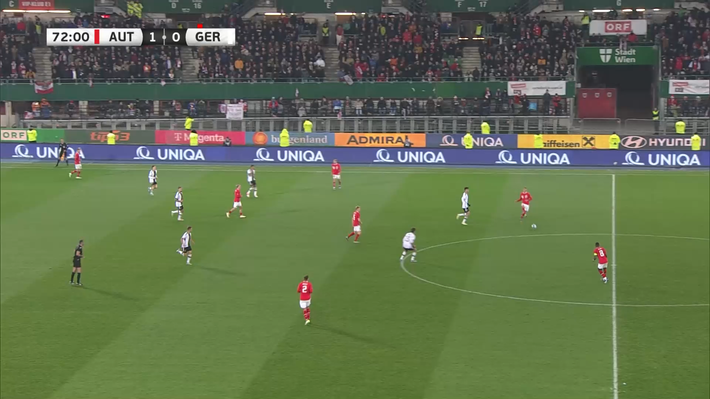
Video extraction
python eventvideo.py 5541745 4480 goal_2.mp4 -hq
31
Notes:
31

Slide 32
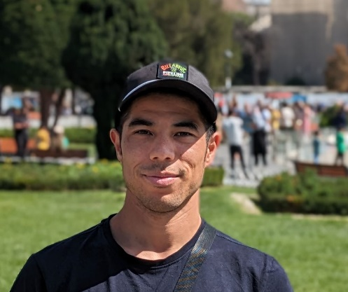

Oliver
Master in CS
Kaggle Expert
Gelati Master
Football Manager Addict
Notes:
32

Slide 33
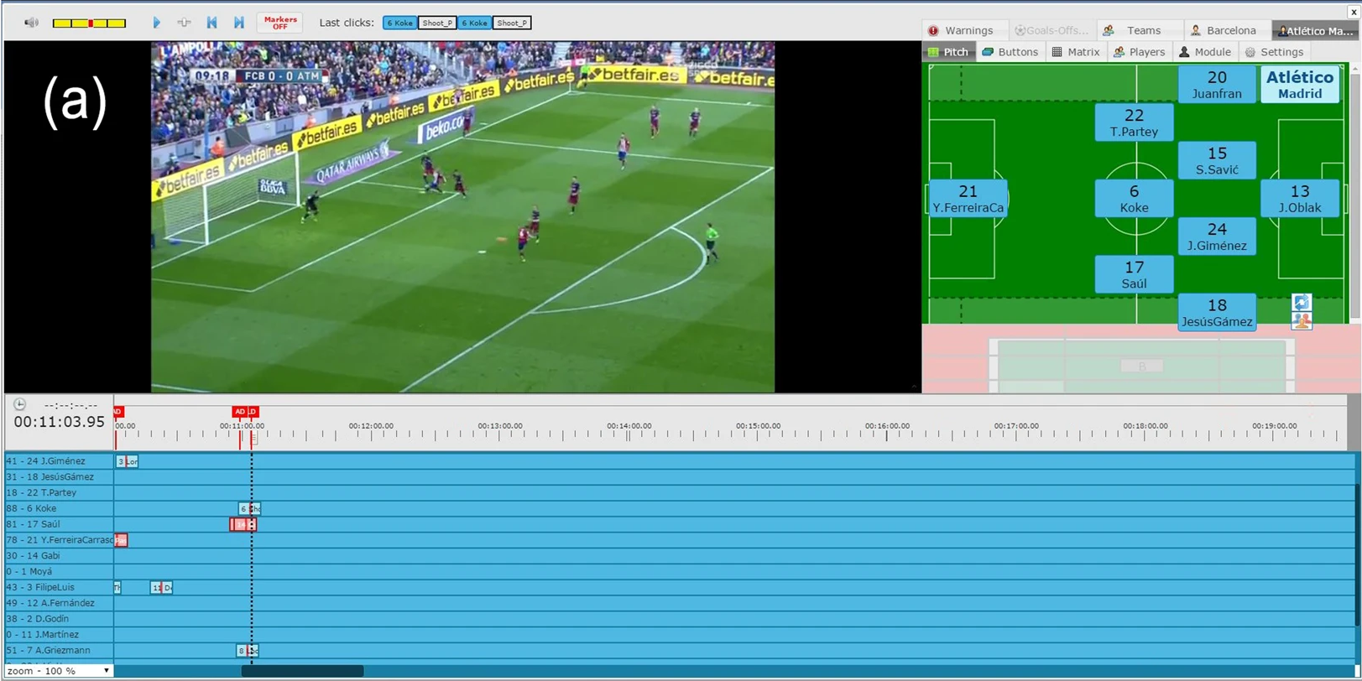
Wyscout Event Data Collection Process
Pappalardo et al. (2019). “A public data set of spatio-temporal match events in soccer competitions”

Slide 34
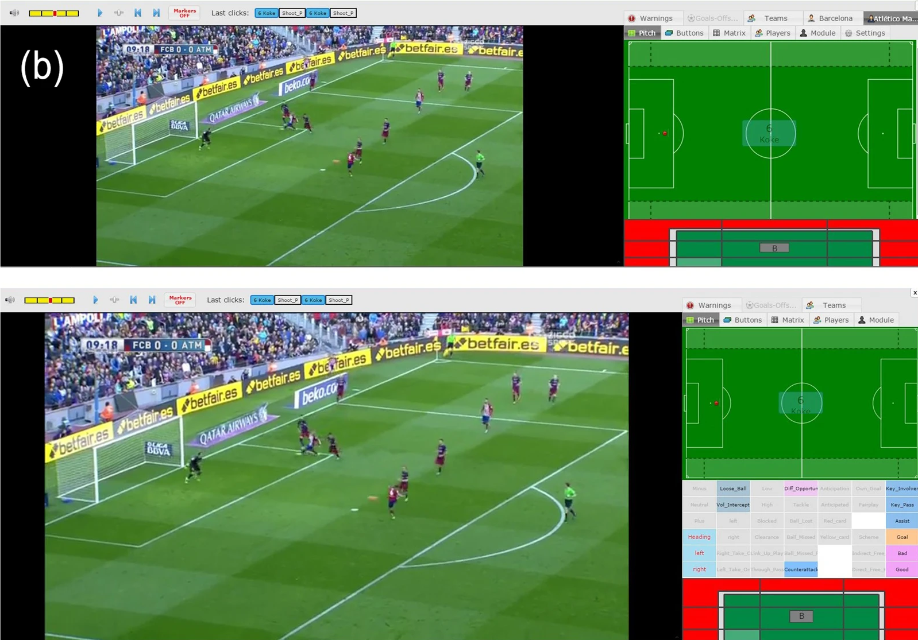
Pappalardo et al. (2019). “A public data set of spatio-temporal match events in soccer competitions”
Notes:
https://www.nature.com/articles/s41597-019-0247-7#Sec5
Explain Step 2: event tagging and Step 3: quality control

Slide 35
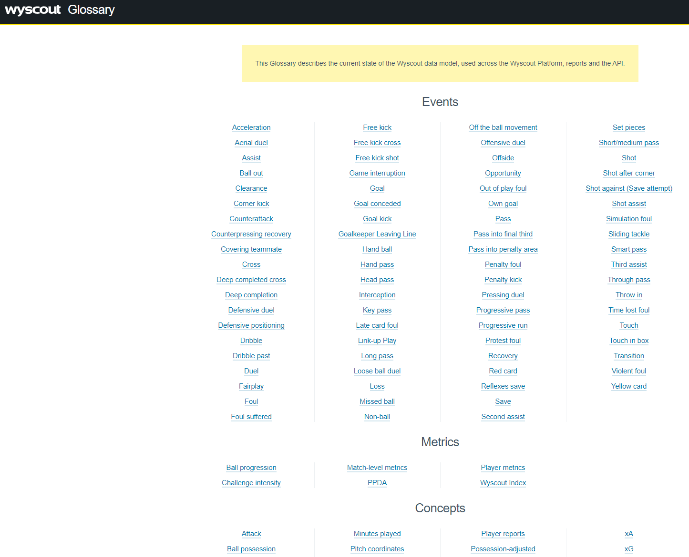
https://dataglossary.wyscout.com

Slide 36
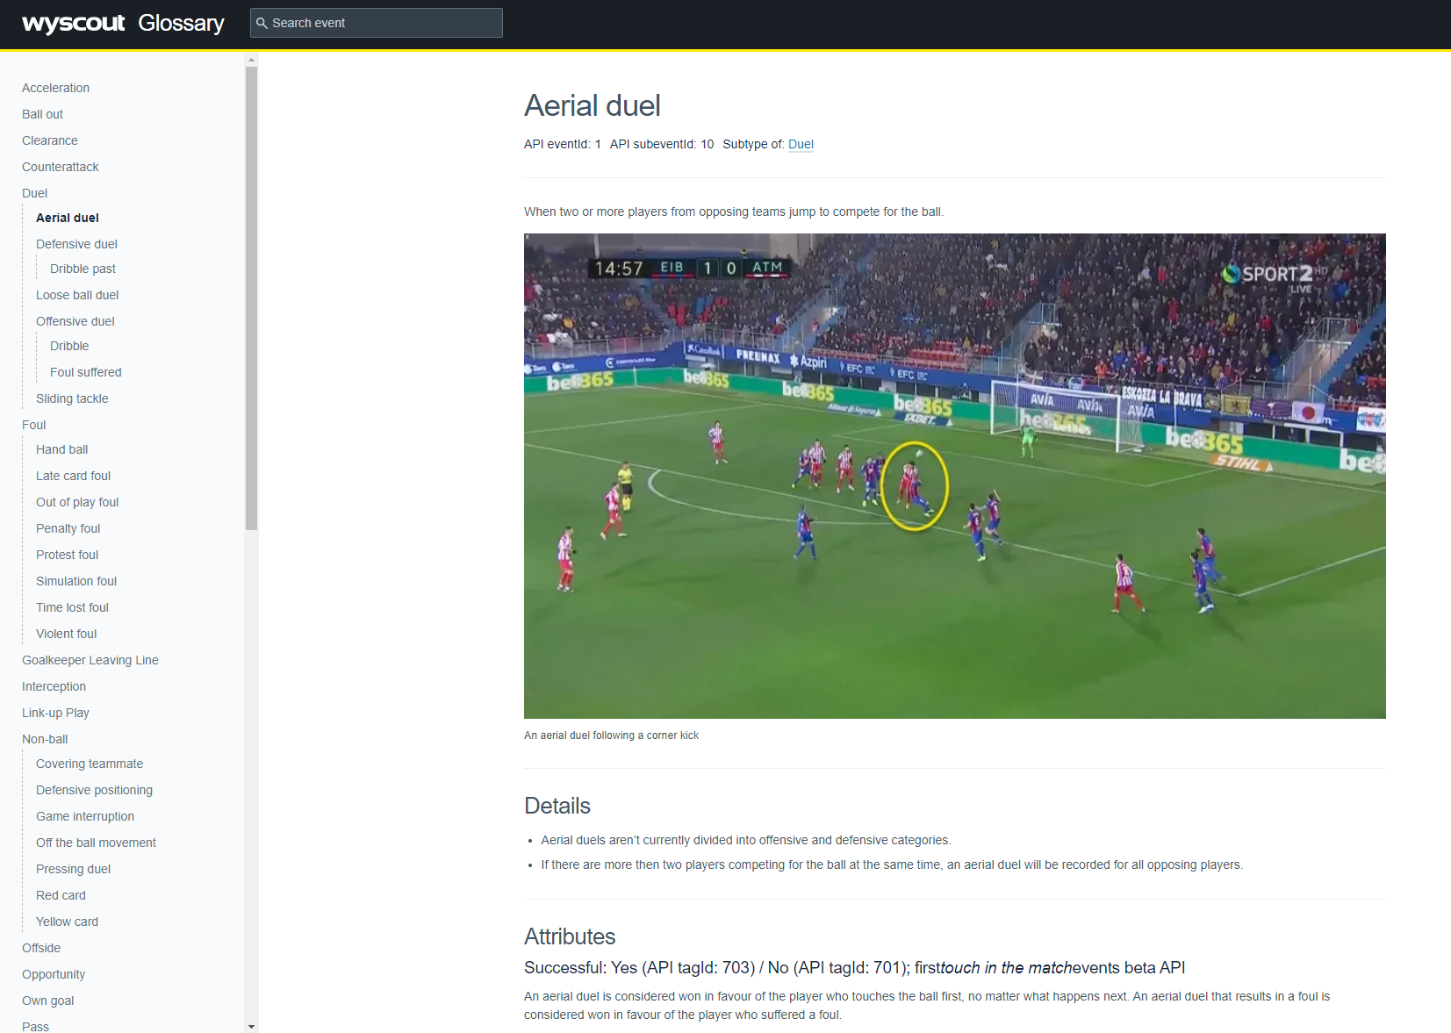

Slide 37
Wyscout Jupter Notebook
Notes:
37

Slide 38
Break!

Slide 39
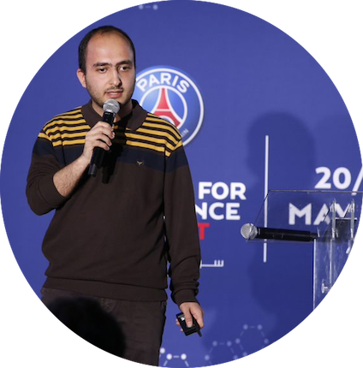


Hadi Sotudeh
Football Analytics Doctoral Student at ETH Zürich
Spatio-temporal Network Analysis of Formation
Characteristics in Association football (Soccer)
Former “Football Data Science” consultant for the Royal Dutch FA
Third place winner in PSG’s sports analytics challenge (2019)
hsotudeh@ethz.ch
Notes:
39

Slide 40

Tracking Data

Slide 41
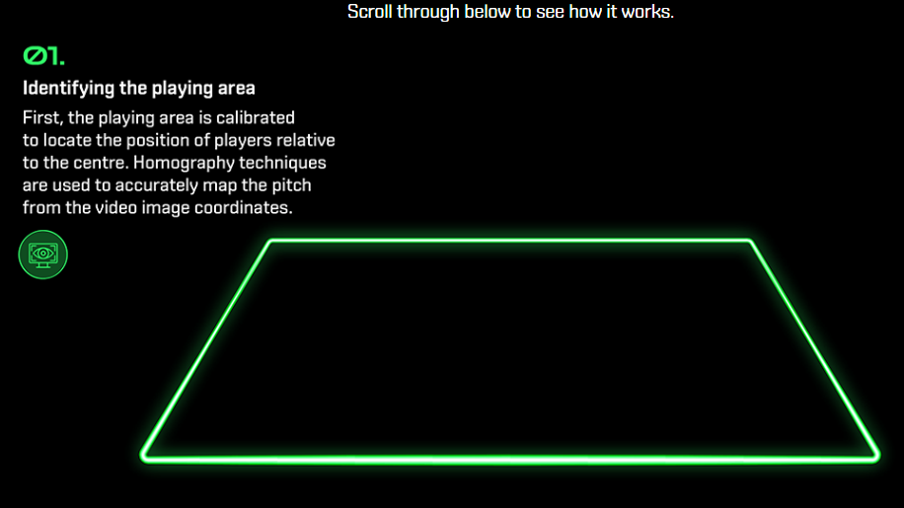

41

Slide 42
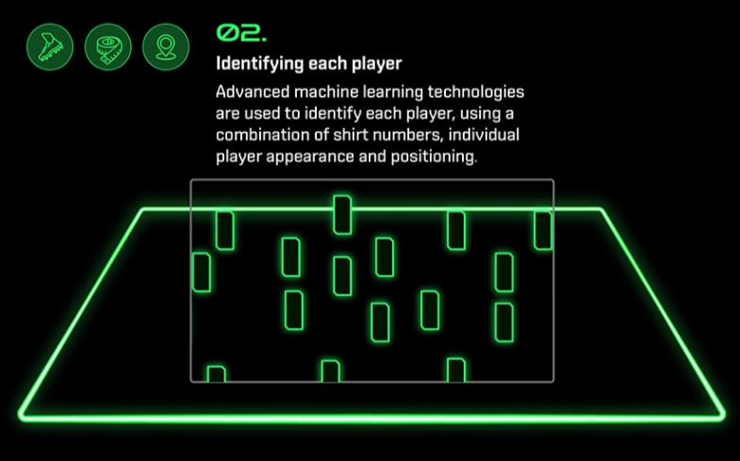
42

Slide 43
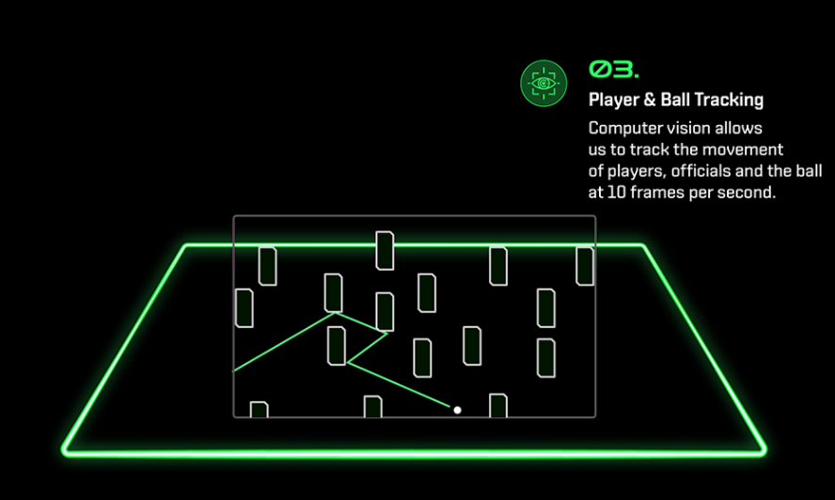
43

Slide 44
44

Slide 45
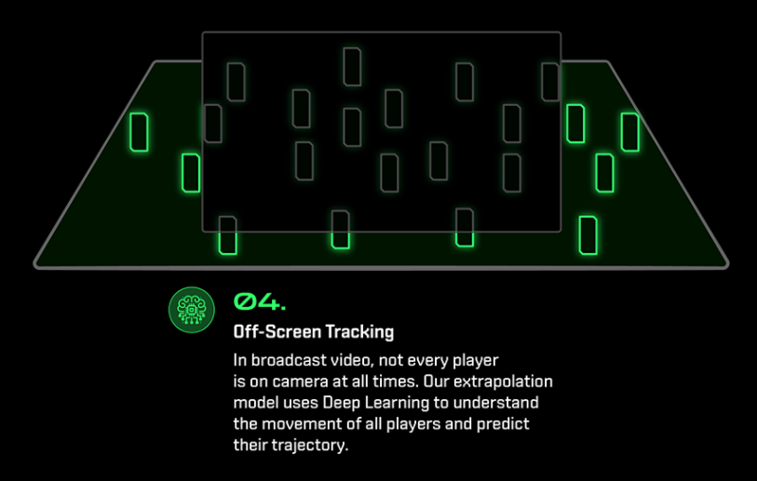
45

Slide 46

46

Slide 47
Documentation

Slide 48
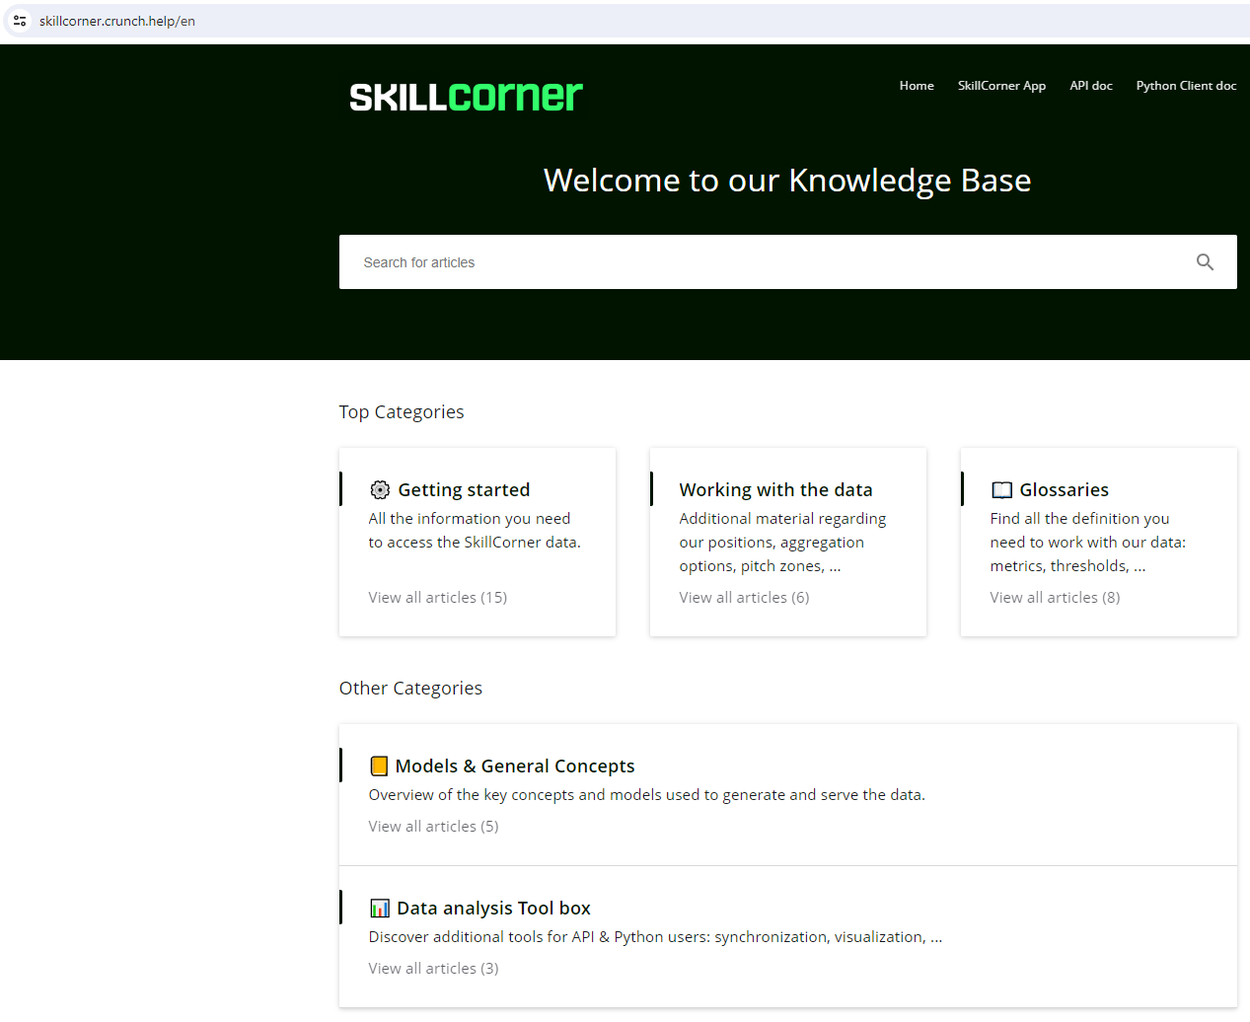

Slide 49
SkillCorner Jupyter Notebook
Notes:
49

Slide 50
Event, Tracking, and Video Data
All Together

Slide 51
A lot of data
Event data
Tracking data
Game Intelligence
Video
Make use of the preprocessing notebooks!
51
Notes:
51

Slide 52
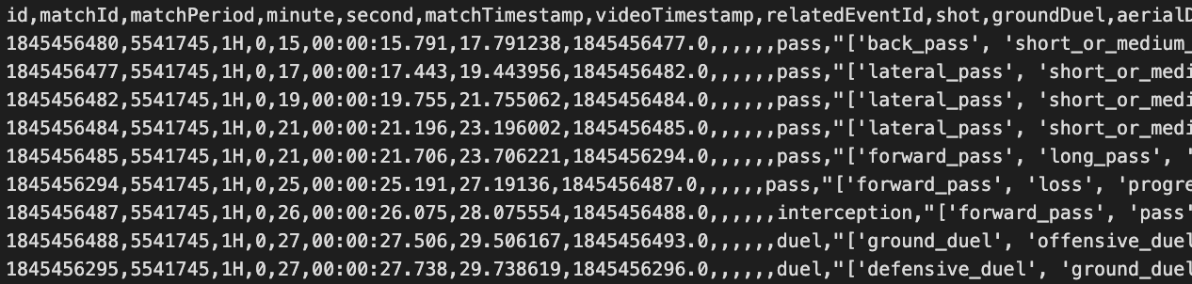
Event & video synchronization
“videoTimestamp” from Wyscout (event) data can be used directly for video extraction.
python eventvideo.py {matchId} {videoTimestamp} videoname.mp4
52
Notes:
52

Slide 53
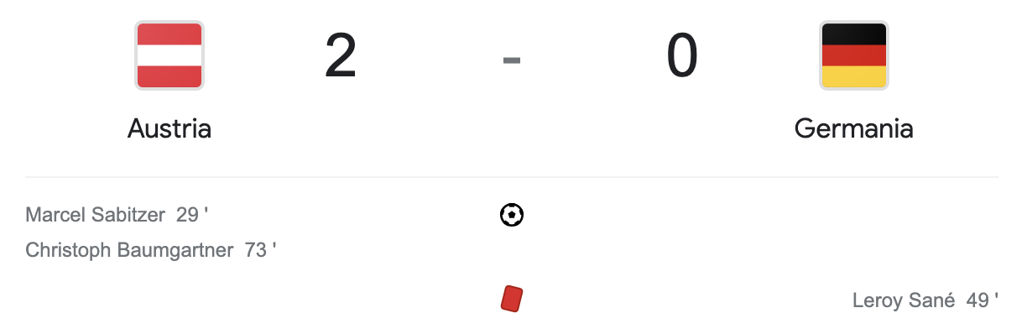
Example: Austria 2 - 0 Germany
Let’s extract the video of the second goal of Austria!
53
Notes:
53

Slide 54
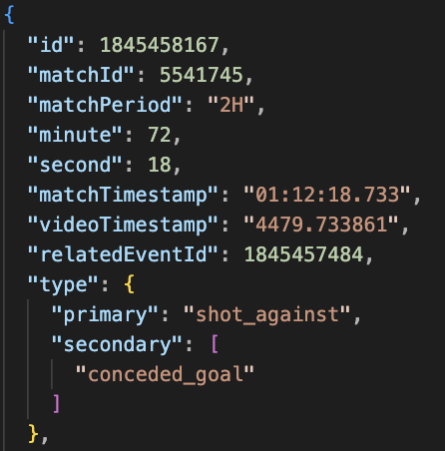
Example: Austria 2 - 0 Germany
Let’s extract the video of the second goal of Austria!
python eventvideo.py 5541745 4480 goal_2.mp4
Event data
54
Notes:
54

Slide 55
Example: Austria 2 - 0 Germany
Let’s extract the video of the second goal of Austria!
55
Notes:
55

Slide 56
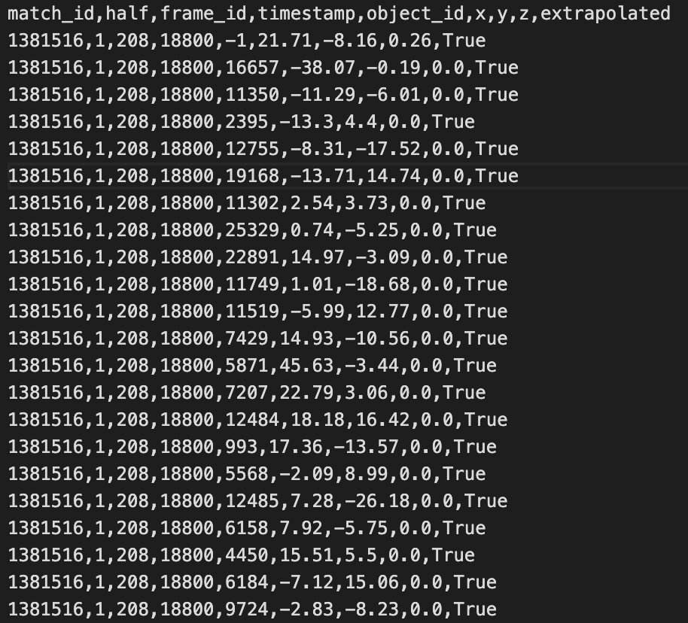
Tracking & event data synchronization
You need synchronization between tracking & event data.
Event data
Tracking data
56
Notes:
56

Slide 57
Tracking & event data synchronization
You need synchronization between tracking & event data.
Event data
Variables “frame_id” and “videoTimestamp” SHOULD BE correlated by a factor of x10.
We tested some games, but you should not give this for granted and ALWAYS check for an offset.
Tracking data
57
Notes:
57

Slide 58

Tracking & event data synchronization
It is a manual process!
Time shifts may be game-dependent. They can also vary between halves.
There is no fixed shift. It might be 0.
“frame_id” and “videoTimestamp” SHOULD BE correlated by a factor of x10.
We tested some games, but you should not give this for granted and ALWAYS check for an offset.
58
Notes:
58

Slide 59
Example
Let’s find the second goal of Austria in the tracking data: in this case, the “frame_id” variable was found to be “videoTimestamp” x 10.
59
Notes:
59

Slide 60
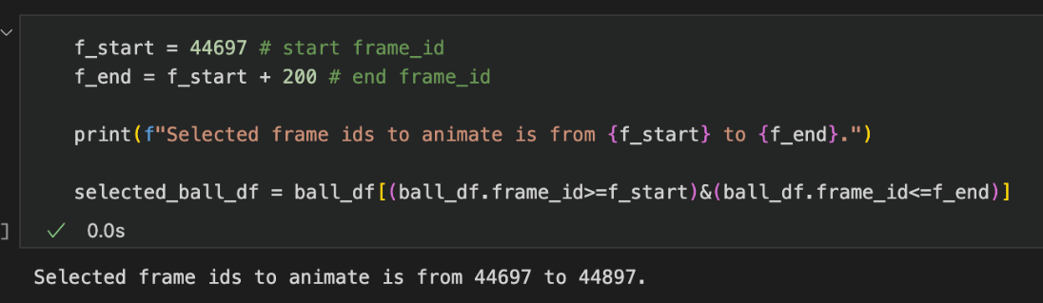
Example
Let’s find the second goal of Austria in the tracking data: in this case, the “frame_id” variable was found to be “videoTimestamp” x 10.
videoTimestamp = 4479.7
frame_id = 44797
skillcorner.ipynb
60
Notes:
60

Slide 61
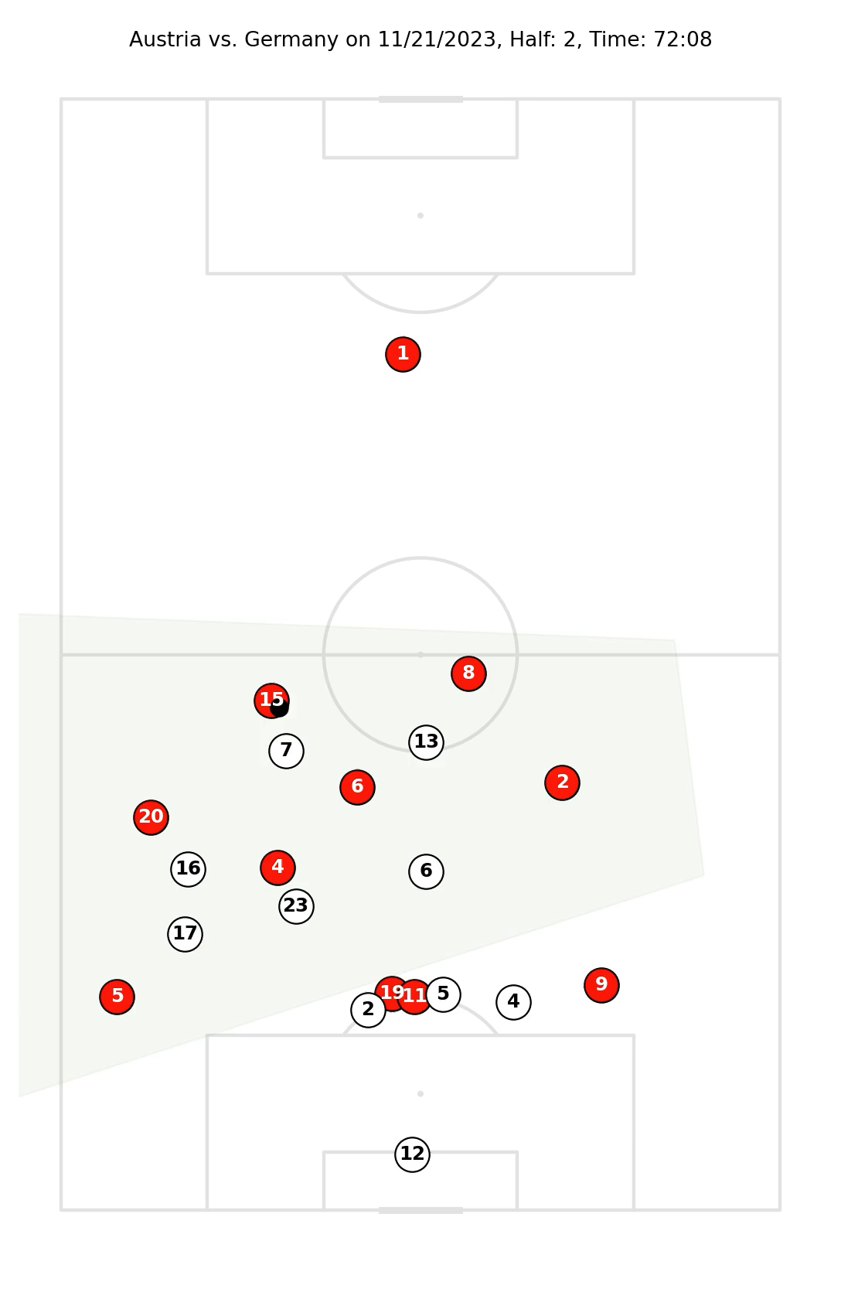
Example
Let’s find the second goal of Austria in the tracking data: in this case, the “frame_id” variable was found to be “videoTimestamp” x 10.
videoTimestamp = 4479.7
frame_id = 44797
skillcorner.ipynb
61
Notes:
61

Slide 62
Data synchronization: takeaway
For every match, always (double) check the correlation between tracking and event data.
62
Notes:
62

Slide 63
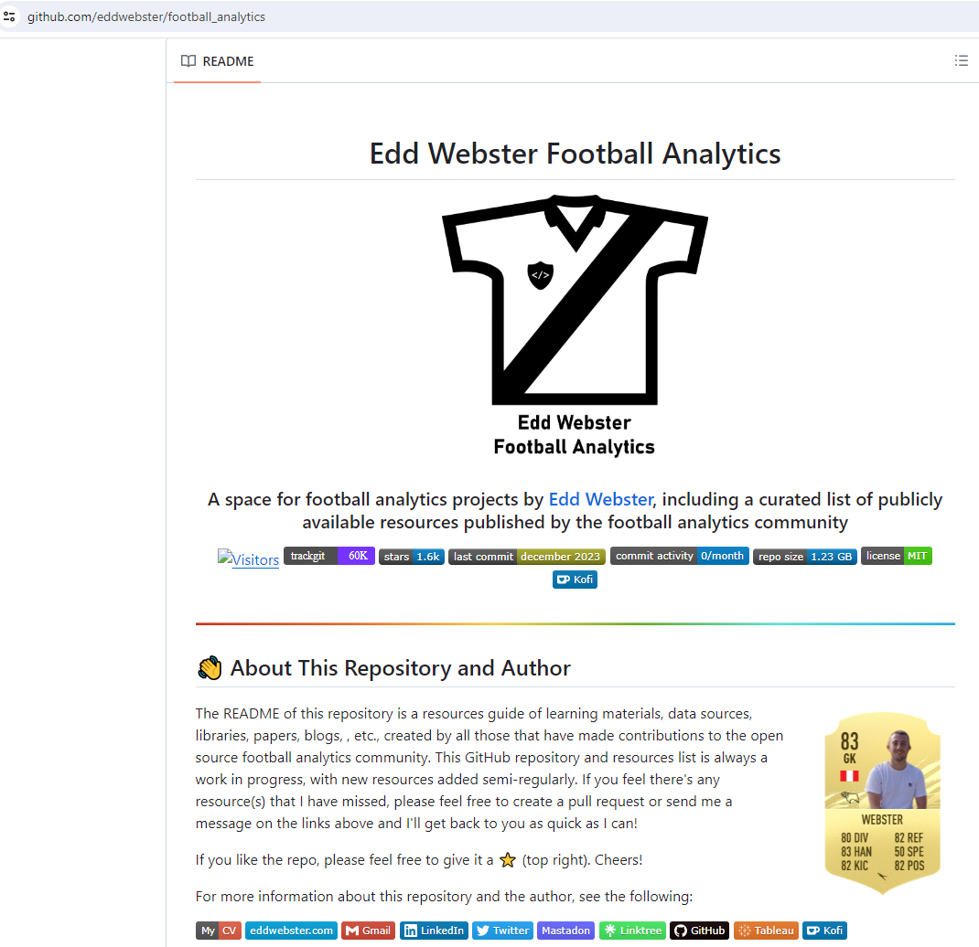
Where to find Useful Tools?
63

Slide 64
Q & A

